Slide 1
Implementation Flaws in Authentication

Slide 2
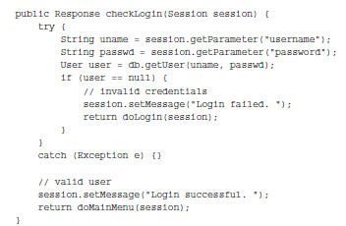
Fail-Open Login Mechanisms

Slide 3
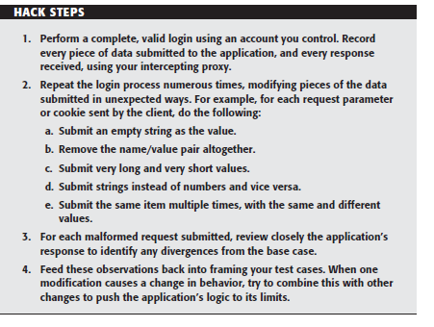
Fail-Open Login Mechanisms

Slide 4
Defects in Multistage Login Mechanisms
Entry of a username and password
A challenge for specifi c digits from a PIN or a memorable word
nThe submission of a value displayed on a changing physical token

Slide 5
Defects in Multistage Login Mechanisms
Potentially Unsafe
An application may assume that a user who accesses stage three must have cleared stages one and two.
An application may trust some of the data being processed at stage two because this was validated at stage one.
An application may assume that the same user identity is used to complete each stage; however, it might not explicitly check this.

Slide 6
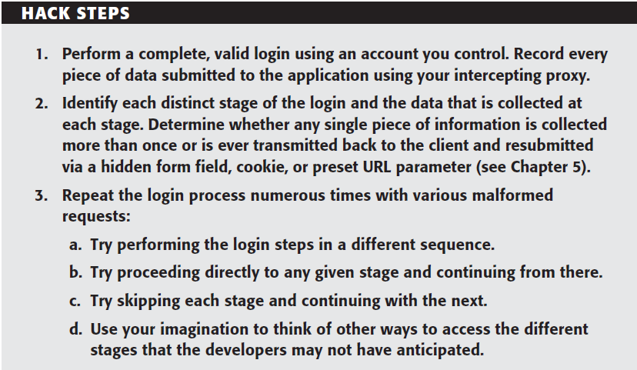

Slide 7
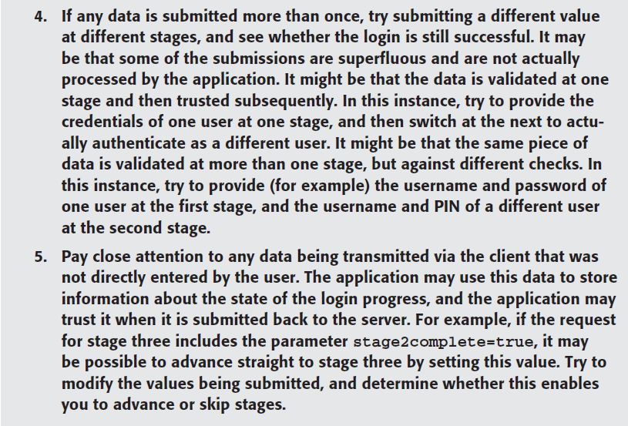

Slide 8
Defects in Multistage Login Mechanisms
login mechanisms employ a randomly varying question at one of the stages of the login process.
Implementation flaw
The application may present a randomly chosen question and store the details within a hidden HTML form field or cookie, rather than on the server.
The application may present a randomly chosen question on each login attempt but not remember which question a given user was asked if he or she fails to submit an answer.

Slide 9
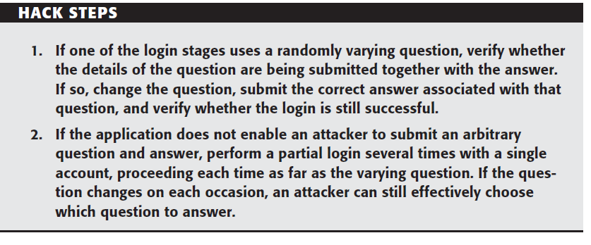
Defects in Multistage Login Mechanisms

Slide 10
Insecure Storage of Credentials
If an application stores login credentials insecurely, the security of the login mechanism is undermined, even though there may be no inherent flaw in the authentication process itself.
This may involve passwords being stored in cleartext. But if passwords are being hashed using a standard algorithm such as MD5 or SHA-1.
Because the database account used by the application must have full read/write access to those credentials,

Slide 11
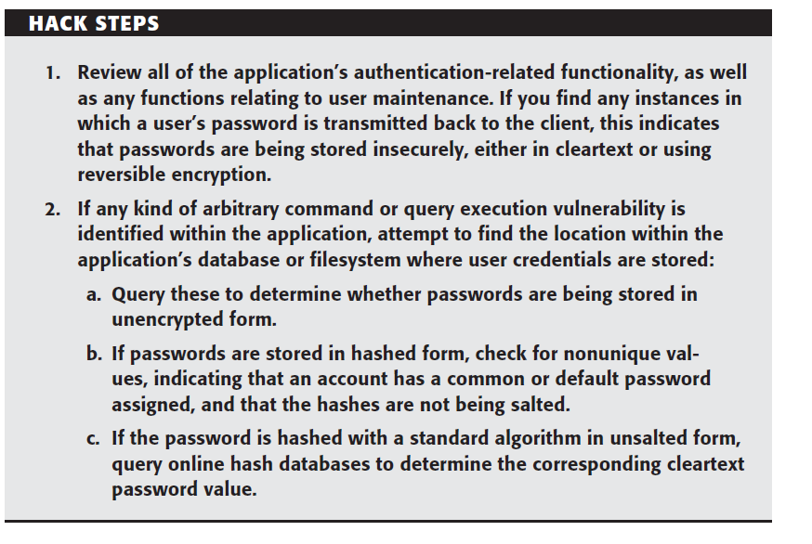
Insecure Storage of Credentials

Slide 12
Securing Authentication
Factor to strike balance
The criticality of security given the functionality that the application offers
The degree to which users will tolerate and work with different types of authentication controls
The cost of supporting a less user-friendly system
The financial cost of competing alternatives in relation to the revenue likely to be generated by the application or the value of the assets it protects

Slide 13
Use Strong Credentials
Use Strong Credentials
Usernames should be unique.
Any system-generated usernames and passwords should be created with sufficient entropy
Users should be permitted to set suffi ciently strong passwords.

Slide 14
Handle Credentials Secretively
All credentials should be created, stored, and transmitted in a manner that does not lead to unauthorized disclosure.
All client-server communications should be protected using a well established cryptographic technology,
If it is considered preferable to use HTTP for the unauthenticated areas of the application, ensure that the login form itself is loaded using HTTPS
Only POST requests should be used to transmit credentials to the server.
Store credentials in a manner that does not allow their original values to be easily recovered,

Slide 15
Handle Credentials Secretively
Client-side “remember me” functionality should in general remember only non secret items such as usernames
A password change facility should be implemented and users should be required to change their password periodically.
Where credentials for new accounts are distributed to users out-of-band, these should be sent as securely as possible and should be time-limited.
Where applicable, consider capturing some of the user’s login information.

Slide 16
Validate Credentials Properly
Passwords should be validated in full.
The application should be aggressive in defending itself against unexpected events occurring during login processing.
All authentication logic should be closely code-reviewed, both as pseudocode and as actual application source code
If functionality to support user impersonation is implemented, this should be strictly controlled to ensure that it cannot be misused to gain unauthorized access.
Multistage logins should be strictly controlled to prevent an attacker from interfering with the transitions and relationships between the stages
Where a login process includes a randomly varying question, ensure that an attacker cannot effectively choose his own question

